Slide 1

Portfolio
CSE0402 E-Commerce and Web Engineering
Saber Ahmed
UG02-44-17-006

Slide 2

Home Page:

Slide 3
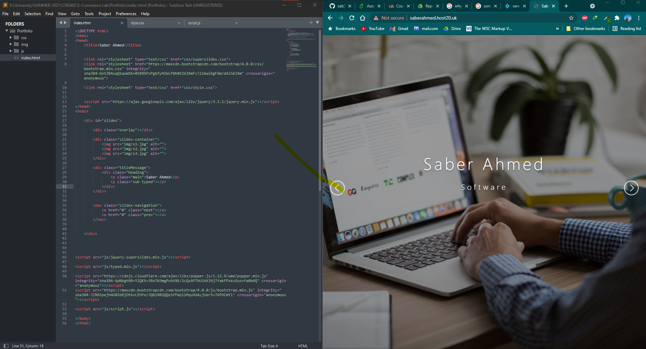
Home Page Codes:

Slide 4
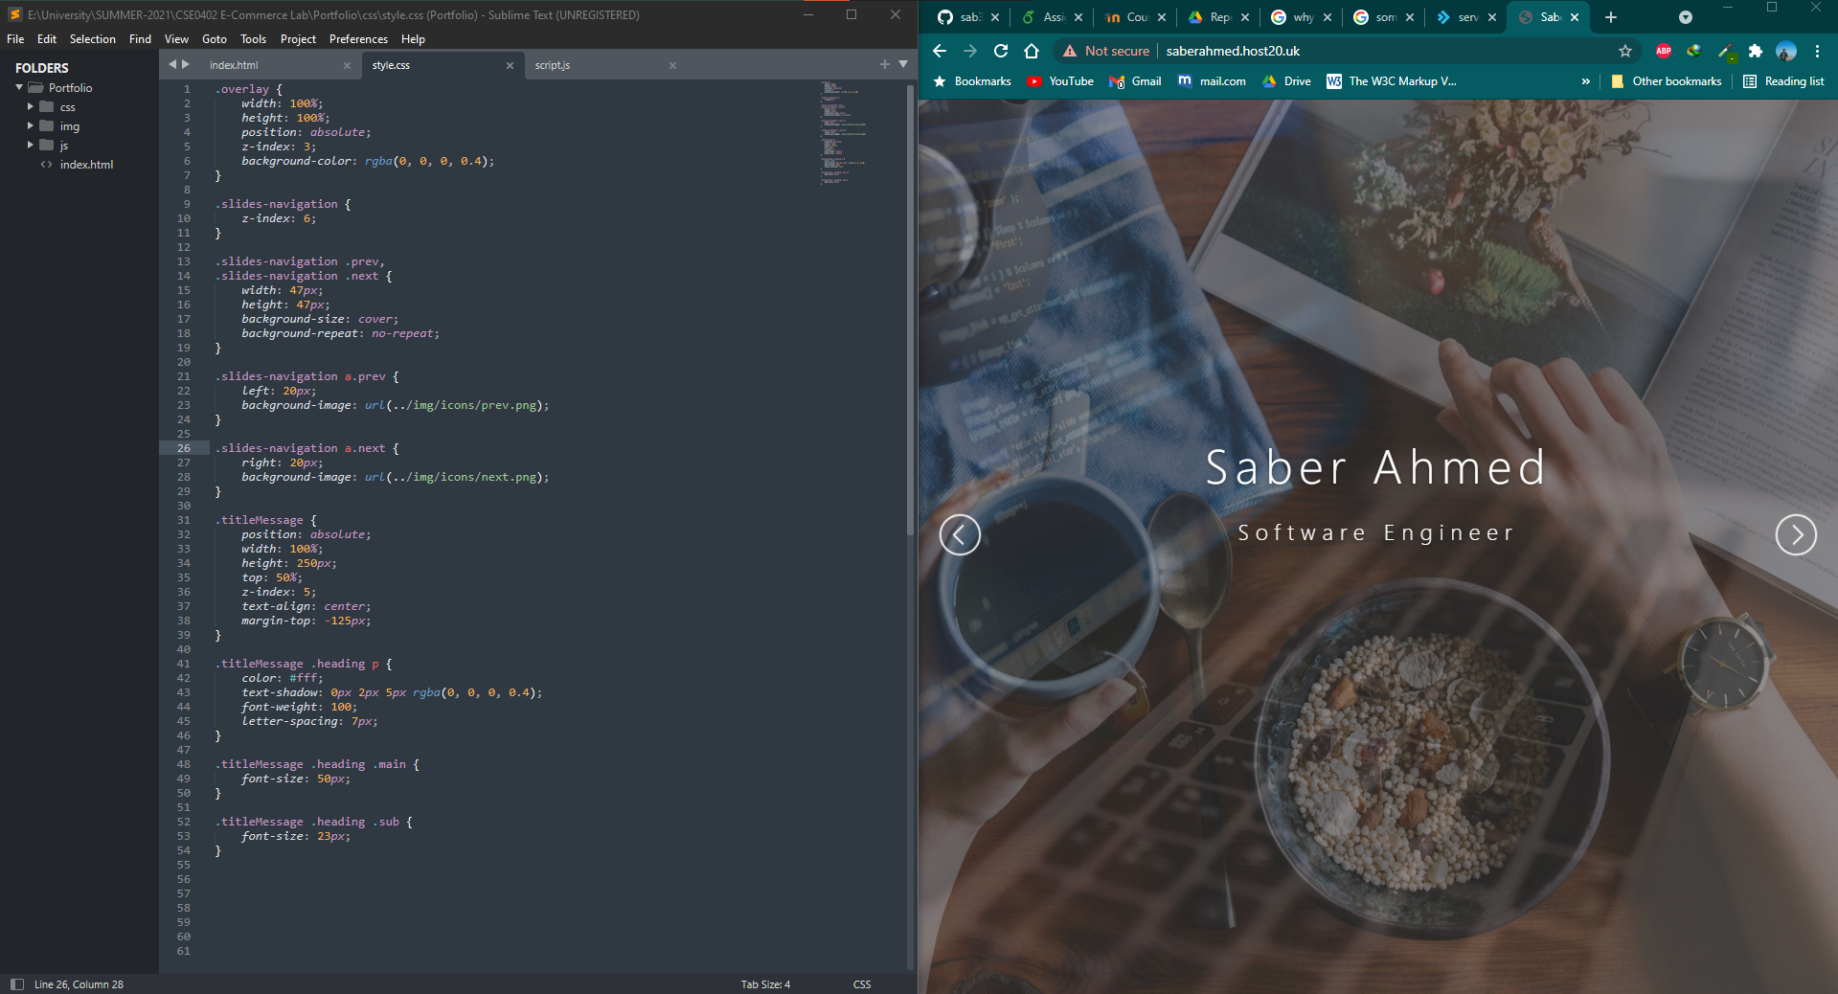
Home Page Codes:

Slide 5
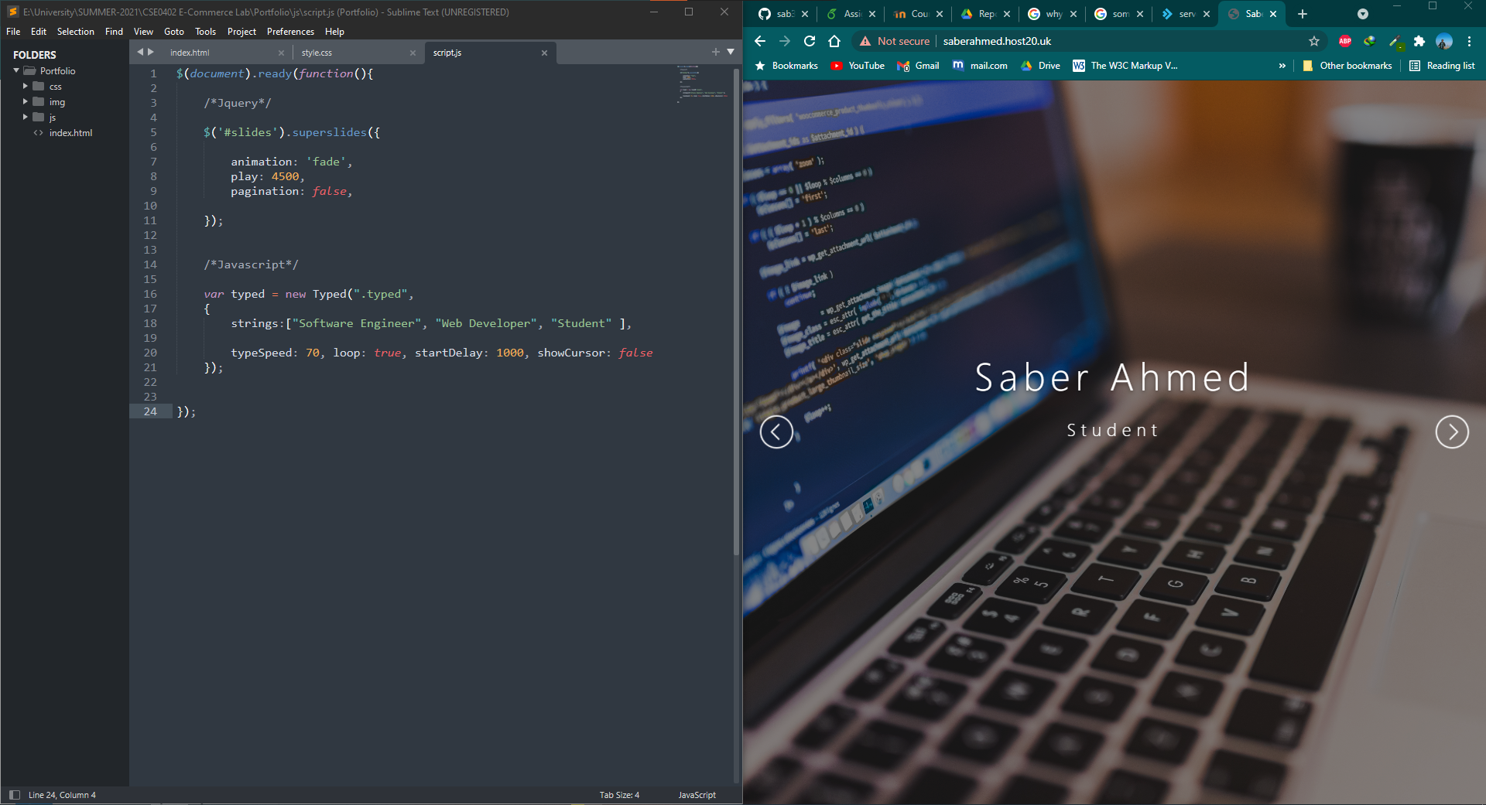
Home Page Codes:

Slide 6
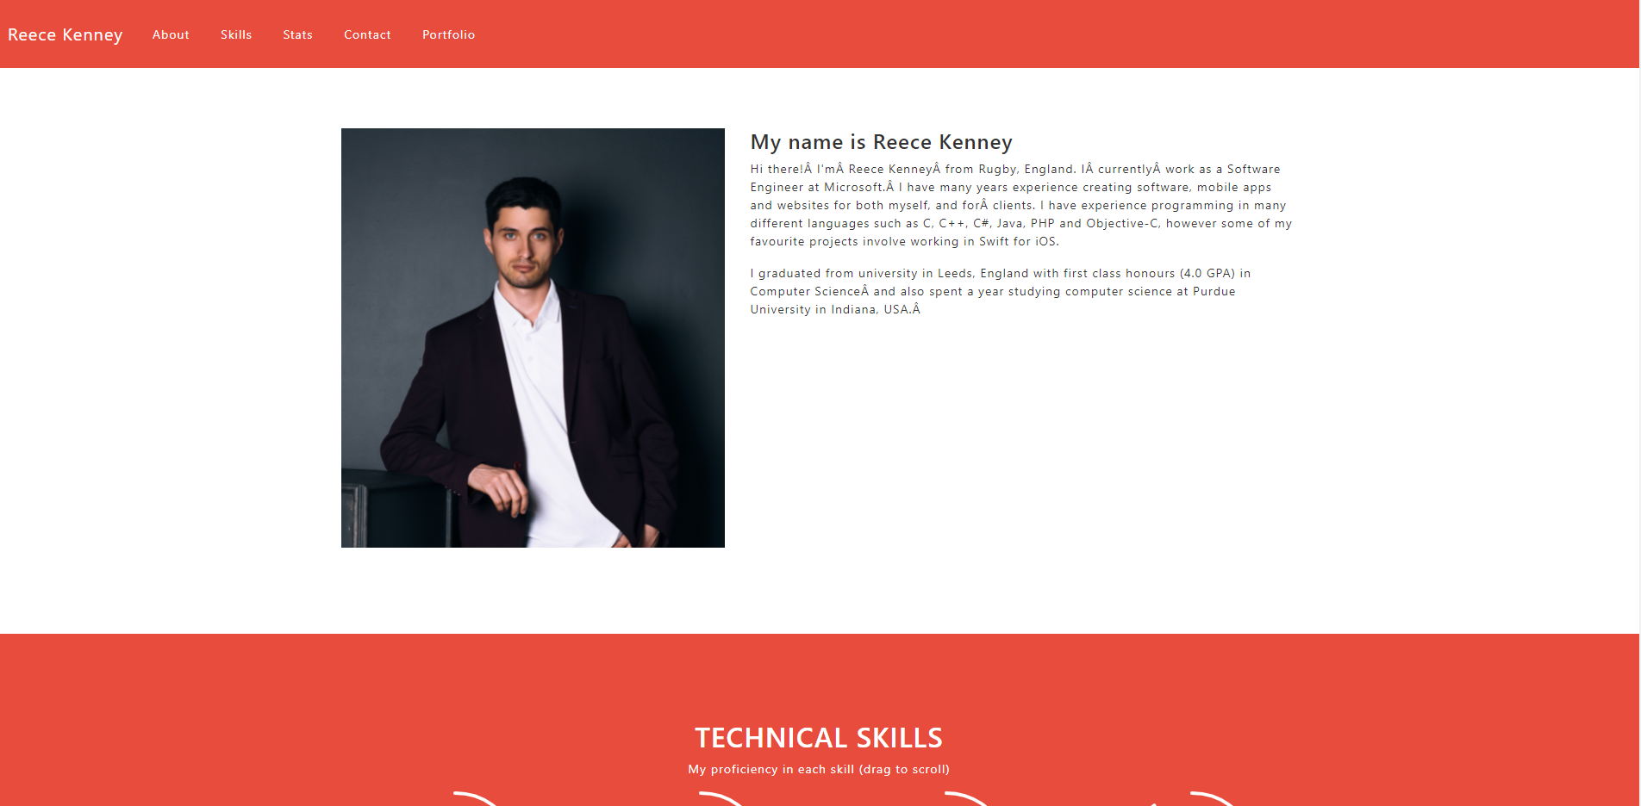
About Section:

Slide 7
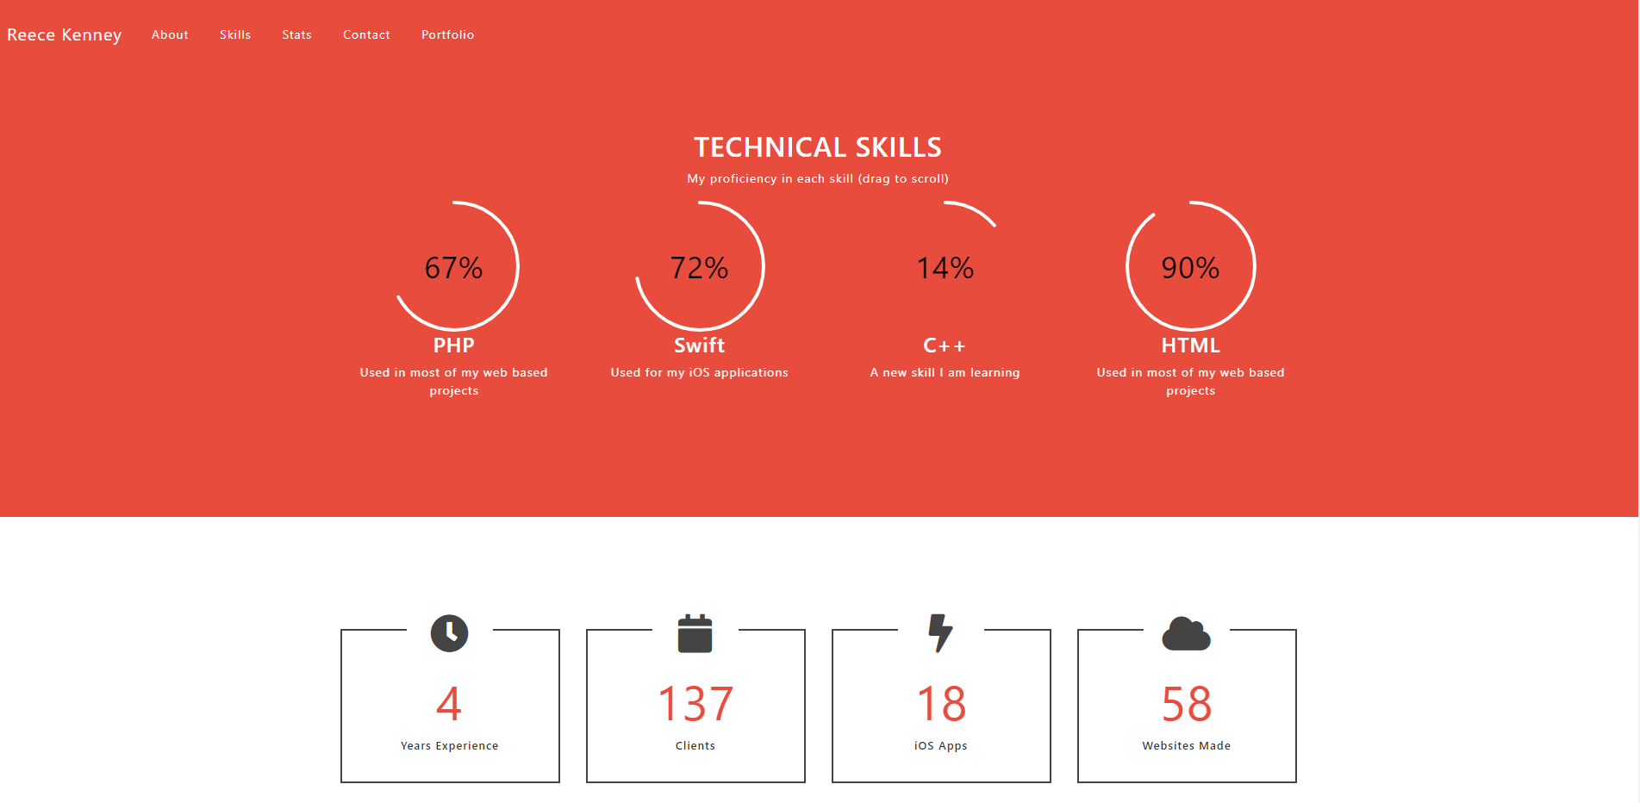
Skills Section:

Slide 8
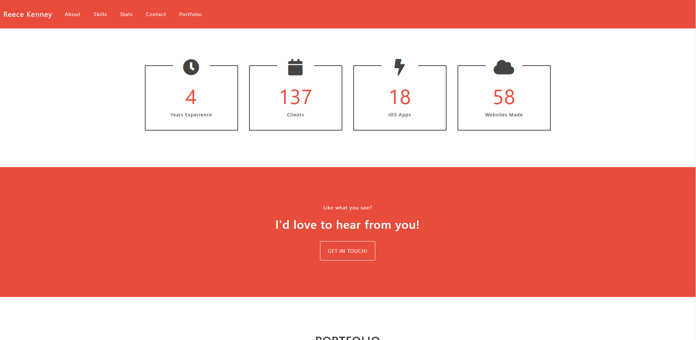
Stats Section:

Slide 9
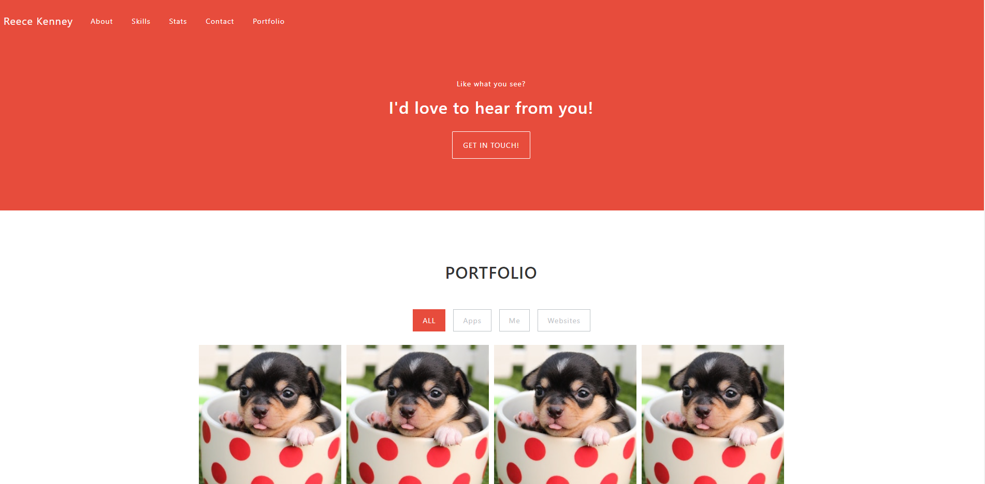
Contact Section:

Slide 10
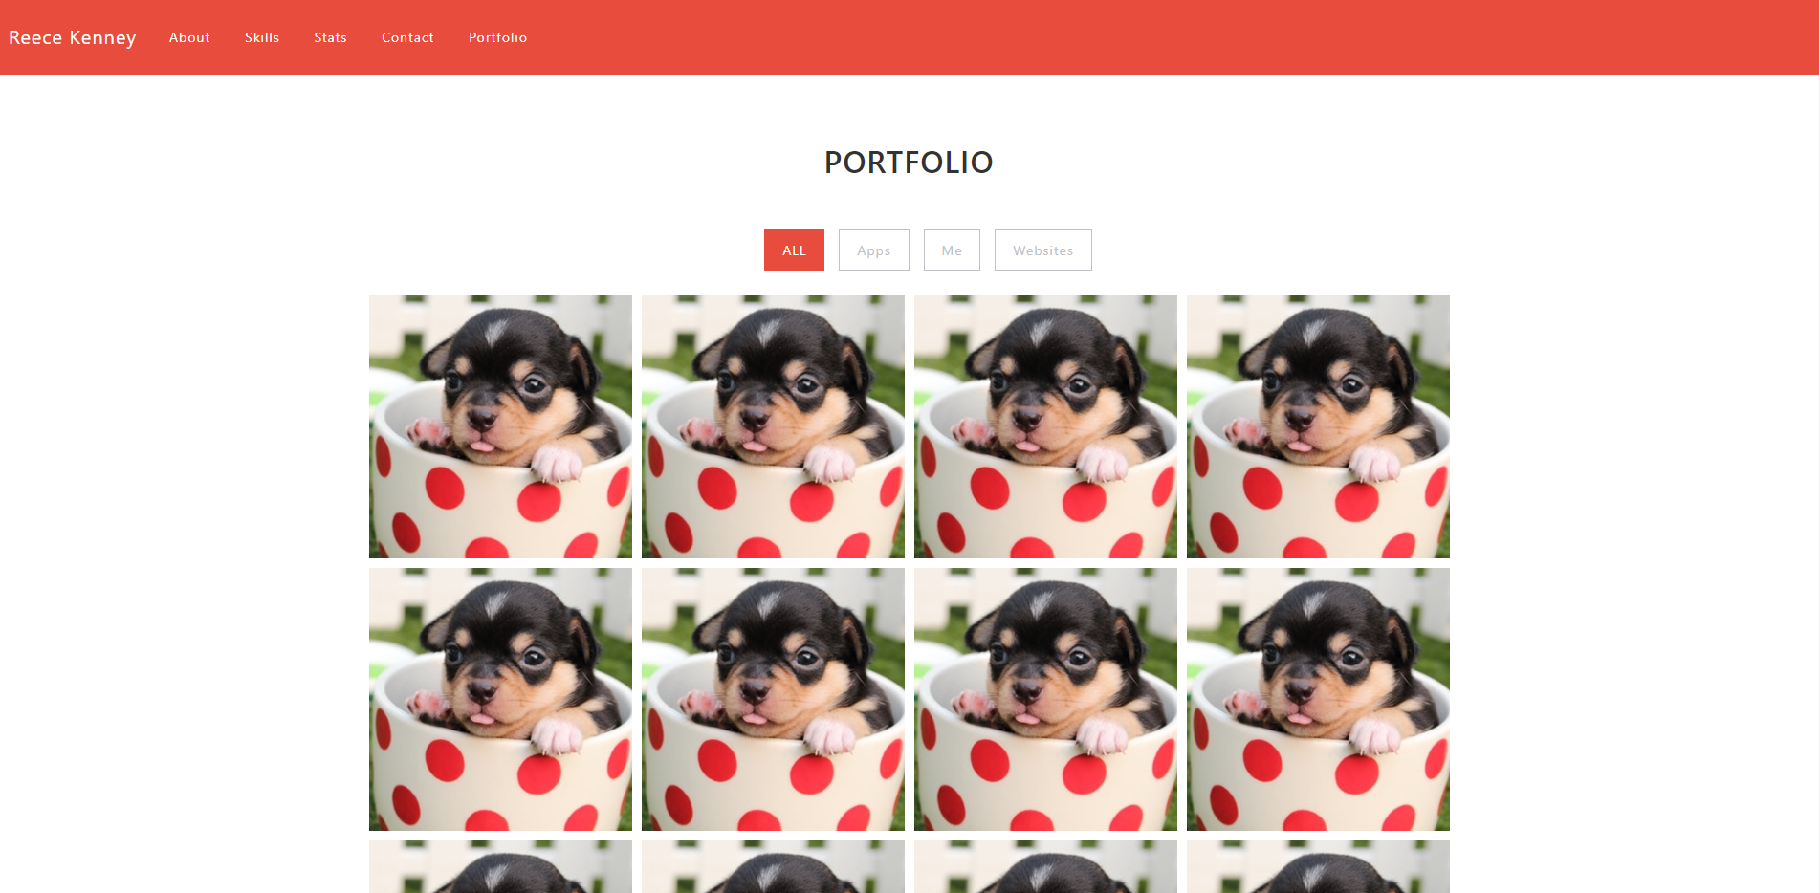
Portfolio Section:

